Slide 1

ECE 281
Digital Design and Computer Architecture Lecture 1
Maj Kevin Walchko, PhD
1

Slide 2




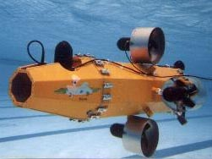



Background – Pre-AF

Slide 3
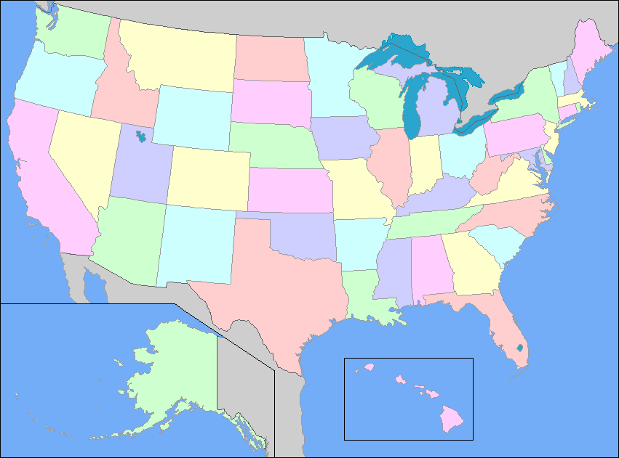
AF Carrier So Far
NRO
Chantilly, VA
CW/DF
USAFA
Space Superiority
LAAFB
AFRL Space Vehicles
Kirtland AFB

Slide 4
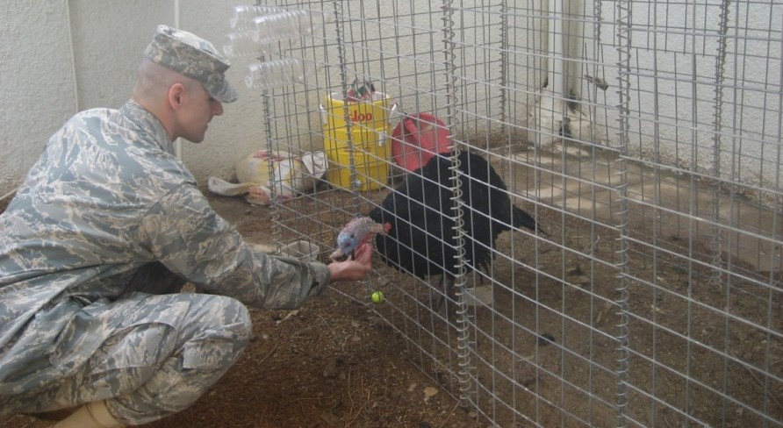
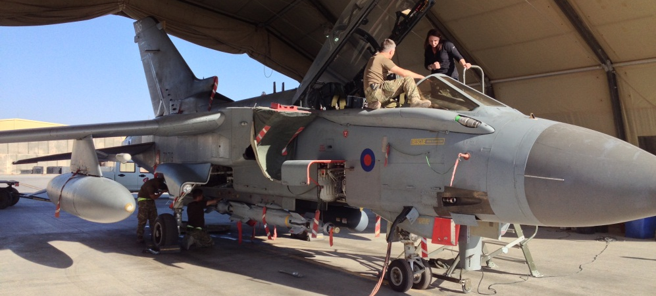
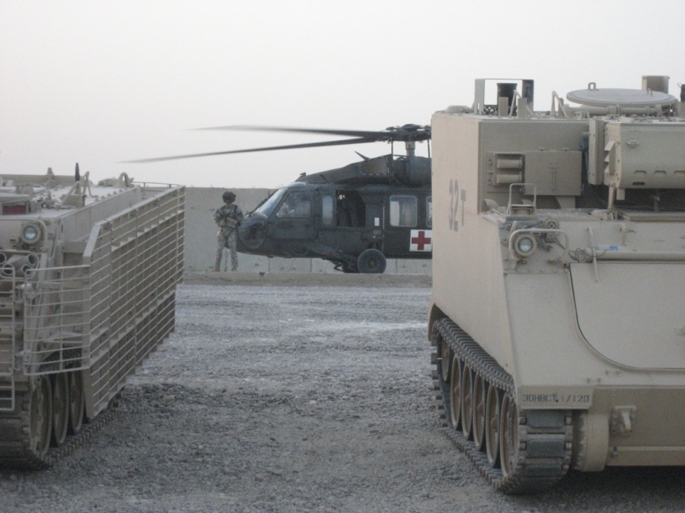
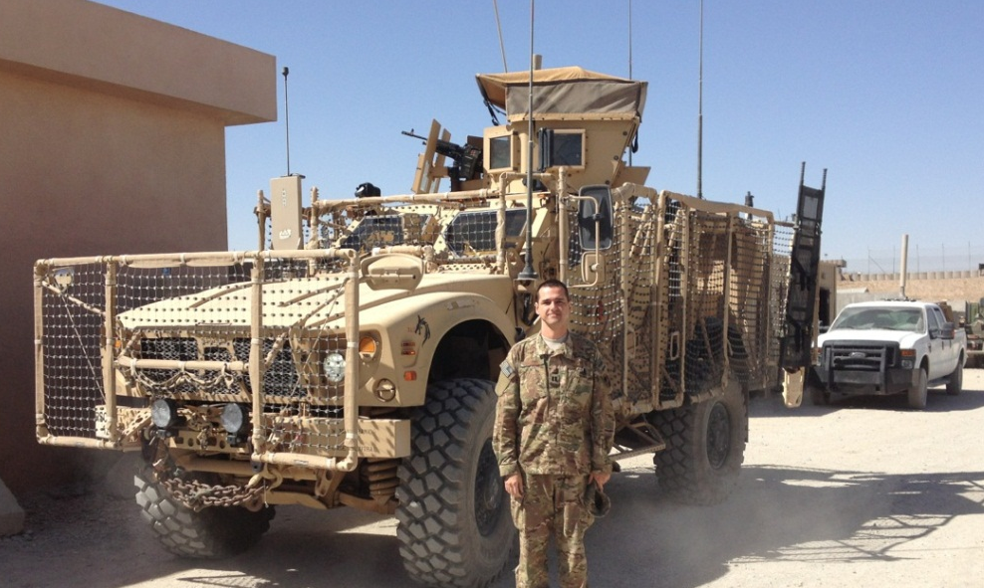



Deployments
Iraq Feb – Aug 09
Afghanistan Sept 13 – Feb 14
DCMA Southern Iraq: LOGCAP
ISAF IJC CJ2: NRO LNO

Slide 5
Roll call & Who are you?
Name
Where are you from?
What is your major?
Desired AFSC?
Why did you join the military?
What fills your time (outside of academics)?
Notes:
Fill out seating chart

Slide 6
Extra Instruction (EI)
M1
T1
Office: 2F48
kevin.walchko@usafa.edu
My schedule is dynamic, so feel free to send me a meeting invite or email for EI
M2
T2
M3
T3
M4
T4
Available
M5
T5
Sometimes Available
M6
T6
Always Unavailable
M7
T7

Slide 7
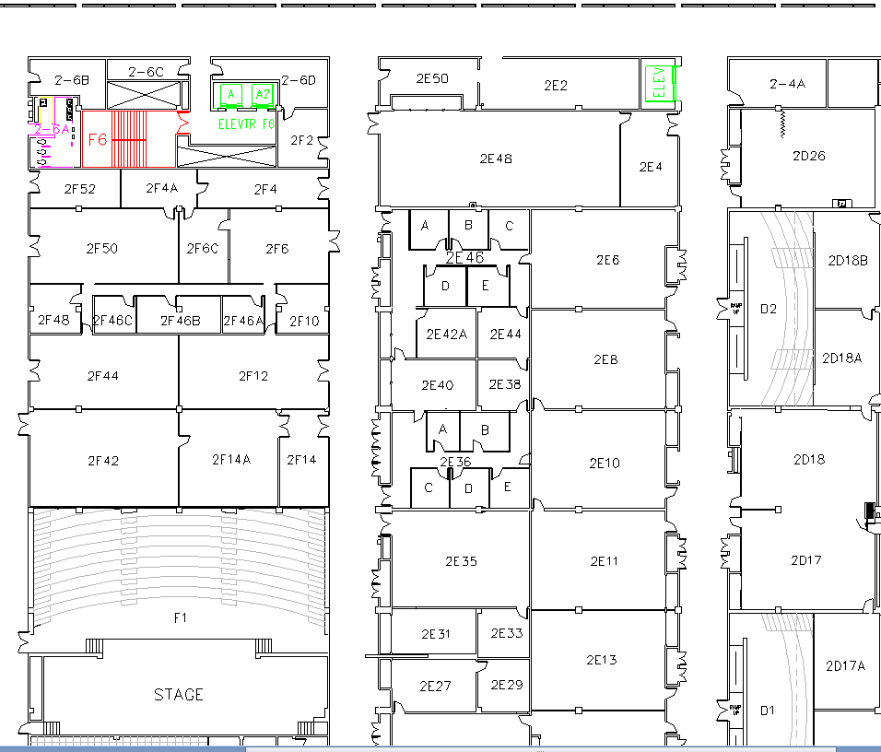
West (Terrazzo) Side
You are here

Slide 8
Expectations
Read and be familiar with course materials (e.g., syllabus, readings, etc)
To be successful, you MUST do HW problems/CE/labs/etc
Don’t rely on others too much
Read the day’s materials before the class
I will not cover every detail
No surfing the internet/texting/etc during class
Be on time
Be professional
Ask questions during class and stay engaged
If you need to miss class due to an SCA, please let me know as soon as you do (ASAP)!
Remember: This class is for you to learn, not for me to teach

Slide 9
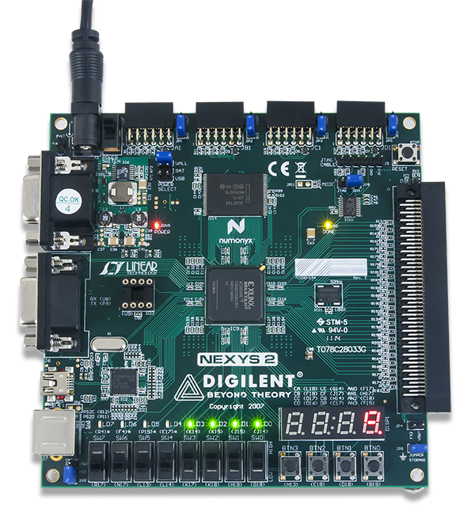
Course Overview
The required textbook is Digital Design Principles and Computer Architecture Second Edition, by David Money Harris & Sarah L. Harris
Software: Xilinx ISE 14.7
Course website is on SharePoint
The K drive also is a good resource: K:\DF\DFEC\ECE281
Block I
Basic combinational logic
Sequential Logic
Block II
VHDL
Digital Building Blocks
Block III
Computer architecture

Slide 10
Grade Distribution
 | Prog | Final
GRs (2) | 35 % | 25 % |  | Grade | Grade
Labs (4) | 35 % | 25 % |  | 90 ≤ A ≤ 100 | 74 ≤ C+ < 77
Computer Exercises (4) | 20 % | 15 % |  | 87 ≤ A- < 90 | 70 ≤ C < 74
Quizzes & Homework | 10 % | 10 % |  | 84 ≤ B+ < 87 | 67 ≤ C- < 70
Final Exam |  | 25 % |  | 80 ≤ B < 84 | 60 ≤ D < 67
 |  |  |  | 77 ≤ B- < 80 | F < 60
TOTAL | 100 % | 100 %
Note: you have to get a 60% weighted average on the GRs and Final to pass the course.

Slide 11
Late Policy
How Late? |  | Penalty | Max Grade
1 calendar day | < 24 hrs | 25% | 75%
2 days | 24 to 48 hrs | 50% | 50%
3 days | 48 to 72 hrs | 75% | 25%
4 days or more | 72 + hrs | 100% | 0%
Note: Late time includes weekends and holidays. Make prior arrangements for weekend or holiday turn-in. All assigned work must be turned in to pass the course—even if it’s too late to receive any credit.

Slide 12
Other Course Policies - Labs
Bitbucket to turn in lab materials bitbucket.org
Class time is provided, but come prepared!
The labs will require debugging—53 minutes goes by quickly
Do the prelab, if there is one
There’s a late penalty for each prelab section not completed before you come to class

Slide 13
Other Course Policies
Collaboration
Check the collaboration policy on each assignment
Generally OK to collaborate on homework, computer exercises, labs, and preflights—but all written work, including code, must be in your own words
Document any help/collaboration
Quizzes, GRs, and Final
Let me know ahead of time if you’re going to miss a graded evaluation so we can schedule you to do it ahead of time
Computer Exercises
Familiarize you with the software used in the course. You will have to use what you learn when you do the labs

Slide 14
Abstraction
Hiding details when they aren’t important
Copyright © 2007 Elsevier

Slide 15
The Digital Abstraction
Most physical variables are continuous, for example
Voltage on a wire
Frequency of an oscillation
Position of a mass
Instead of considering all values, the digital abstraction considers only a discrete subset of values
Copyright © 2007 Elsevier

Slide 16
The Three -Y’s
Hierarchy
A system divided into modules and submodules
Modularity
Having well-defined functions and interfaces
Regularity
Encouraging uniformity, so modules can be easily reused
Copyright © 2007 Elsevier

Slide 17
Number Systems Expanded Normal Form
Decimal numbers
Binary numbers
Copyright © 2007 Elsevier

Slide 18
Number Systems
Decimal numbers
Binary numbers
Copyright © 2007 Elsevier

Slide 19
Hexadecimal Numbers
Hex Digit | Decimal Equivalent | Binary Equivalent | Octal Equivalent
0 | 0 | 0000 | 0
1 | 1 | 0001 | 1
2 | 2 | 0010 | 2
3 | 3 | 0011 | 3
4 | 4 | 0100 | 4
5 | 5 | 0101 | 5
6 | 6 | 0110 | 6
7 | 7 | 0111 | 7
8 | 8 | 1000 | 10
9 | 9 | 1001 | 11
A | 10 | 1010 | 12
B | 11 | 1011 | 13
C | 12 | 1100 | 14
D | 13 | 1101 | 15
E | 14 | 1110 | 16
F | 15 | 1111 | 17
Copyright © 2007 Elsevier

Slide 20
Number System Conversions
 | Convert To:
Convert From: | Binary | Octal | Hexadecimal | Decimal
Binary | X | Substitution | Substitution | Summation
Octal | Substitution | X | Substitution | Summation
Hexadecimal | Substitution | Substitution | X | Summation
Decimal | Division | Division | Division | X
Division: Divide a number of larger base by the lower base and assign the remainder as the LSB up to the MSB.
Summation: Use the positional numbering system to multiply the digit by the power of the position (A_{n}b^{n} + A_{n-1}b^{n-1} + … + A₁b¹+ A₀b⁰ = ).
Substitution: The Rule of Threes (for binary ⬄ octal) and the Rule of Fours (for binary ⬄ hexadecimal)

Slide 21
Bits, Bytes, Nibbles…
Bits
Bytes & Nibbles
Bytes
Copyright © 2007 Elsevier

Slide 22
Bitbucket
Create Private Bitbucket Repository
https://bitbucket.org/
Name repo something like “ECE281_YourName”
Give me access to repo. My Username: walchko
Example/Template Lab Notebook:
http://ece.ninja/383/lab/labnotebook.html
https://github.com/jfalkinburg/ECE_382_Lab_Ex/

Slide 23
Backups

Slide 24
Course Goals
The goals of this course are for all cadets enrolled in the course to develop the ability to understand and design combinational and sequential circuits and construct, test, and debug these circuits using small and medium scale integrated circuits.
Cadets shall demonstrate an understanding of basic computer architecture and how a computer executes simple programs.

Slide 25
Course Objectives
Demonstrate ability to apply knowledge of math, science, and engineering to analyze combinational and sequential digital circuits.
Demonstrate ability to use small and medium scale integrated circuits to design, construct, test, and debug combinational and sequential circuits.
Demonstrate ability to design combinational and sequential circuits using a hardware description language.
Demonstrate the ability to compile, synthesize, and implement circuit designs on a Field Programmable Gate Array.
Demonstrate ability to write basic assembly language programs, and analyze program execution on a simple computer.
Demonstrate the ability to properly record and report laboratory work.

Slide 26
Other Course Policies
Extra Instruction
Seek EI from me or another instructor
Send a meeting request to set up a time; be sure to let me know if you cancel
Attempt the work before you come
CAS
Precoordinate absences if at all possible
A CAS code doesn’t necessarily mean you’re excused from class (instructor “notification” vs “permission”)

Slide 27
Academics with Honor
Which homework below is considered cheating under the Honor Code?
A 6-page paper which does not have a documentation statement.
A 4-page paper which documents that Cadet X helped the cadet with a specific issue on Problem 5 when the paper was supposed to be individual effort.
A 10-page paper turned in which contains 35 footnotes, but one of them is attributed to the wrong source.
An 8-page paper which Turn-it-in.com shows to contain 4 pages of material that is taken from an internet source but it is not quoted nor the internet source documented

Slide 28
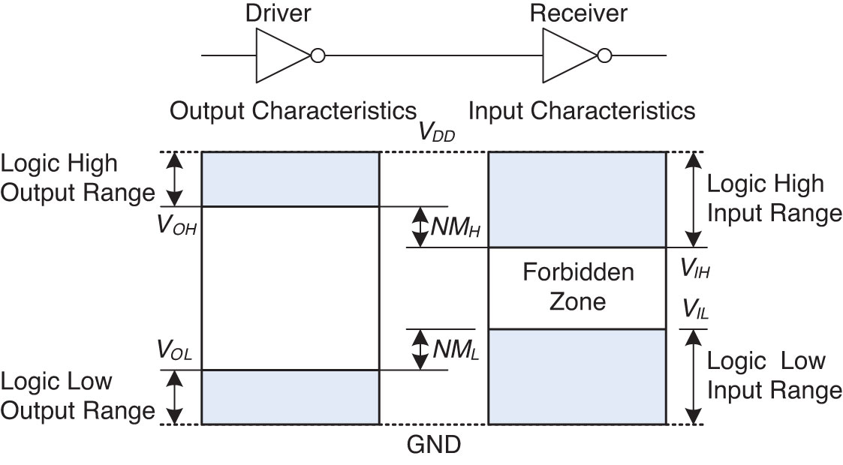
Voltage Levels

Slide 29
Course Text Policy
The required textbook for this course is Digital Design Principles and Computer Architecture Second Edition, by David Money Harris & Sarah L. Harris.
Software: Xilinx ISE 14.7

